Slide 1
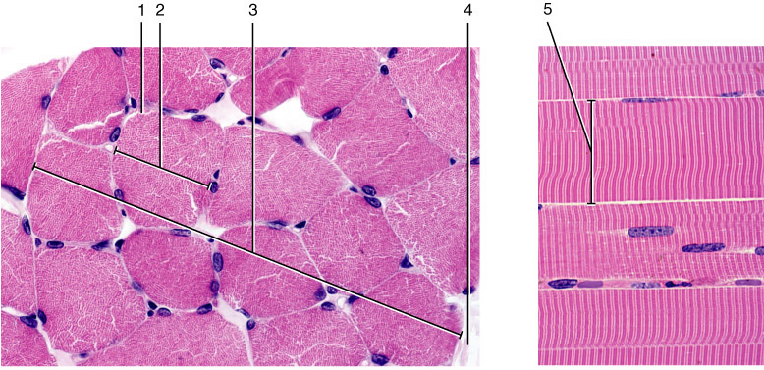
allen2e_12_02_li
Notes:
allen2e_12_02_li.jpg

Slide 2
allen2e_12_02_li
Notes:
allen2e_12_02_li.jpg

Slide 3
allen2e_12_02_li
Notes:
allen2e_12_02_li.jpg

Slide 4
allen2e_12_03_li
Notes:
allen2e_12_03_li.jpg

Slide 5
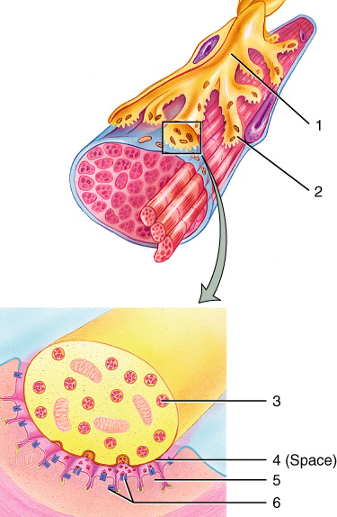
allen2e_12_06_li
Notes:
allen2e_12_06_li.jpg

Slide 6
allen2e_12_06_li
(b)
(c)
Notes:
allen2e_12_06_li.jpg

Slide 7
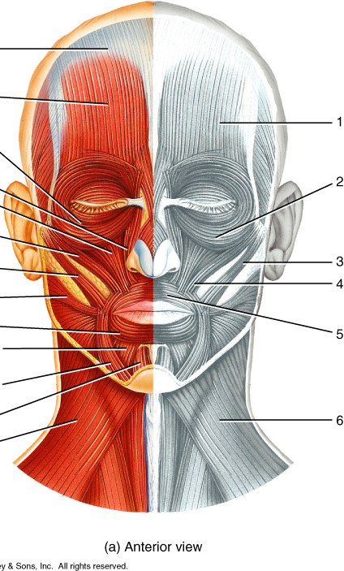
allen2e_14_01a_li
Notes:
allen2e_14_01a_li.jpg

Slide 8
allen2e_14_01a_li
Notes:
allen2e_14_01a_li.jpg

Slide 9
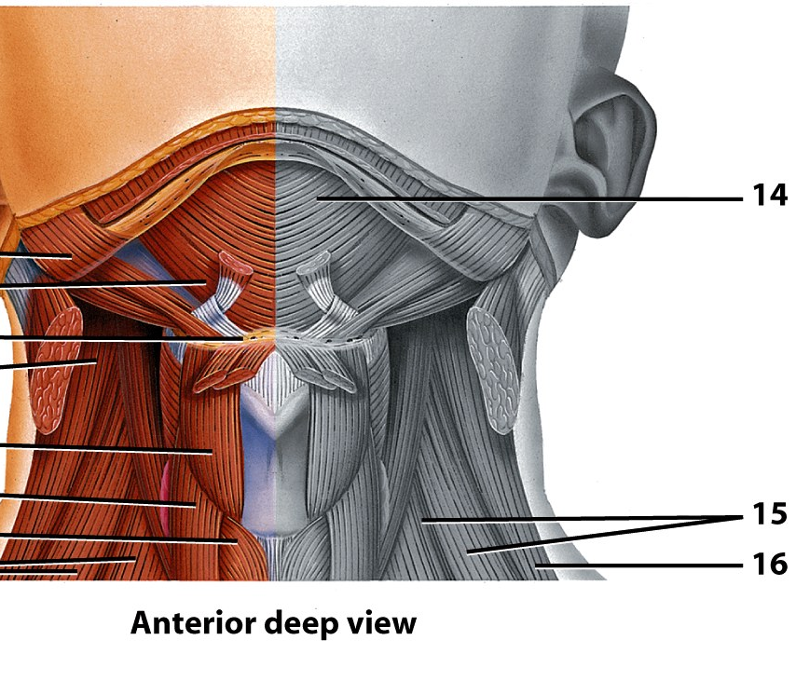

Slide 10
allen2e_14_01bc_li
Notes:
allen2e_14_01bc_li.jpg

Slide 12
allen2e_14_03_li
Notes:
allen2e_14_03_li.jpg

Slide 13
allen2e_14_03_li
Notes:
allen2e_14_03_li.jpg

Slide 14
allen2e_14_04a_li
Notes:
allen2e_14_04a_li.jpg

Slide 15
allen2e_14_04a_li
Notes:
allen2e_14_04a_li.jpg

Slide 16
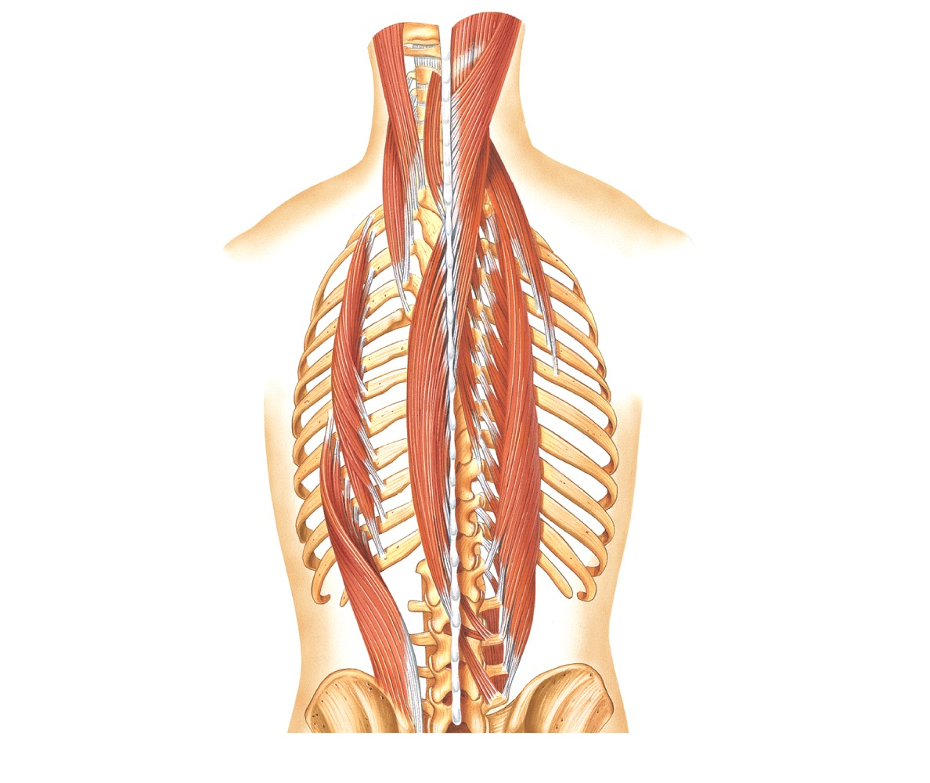
Semispinalis capitis
Longissimus capitis
Spinalis capitis
Spinalis cervicis
Splenius capitis
Longissimus cervicis
Semispinalis cervicis
Longissimus thoracis
Iliocostalis thoracis
Semispinalis thoracis
Spinalis thoracis
Iliocostalis lumborum
(c) Deep erector spinal muscles of the back

Slide 17
allen2e_14_05_li
Notes:
allen2e_14_05_li.jpg

Slide 18
allen2e_14_06ab_li
Notes:
allen2e_14_06ab_li.jpg

Slide 19
allen2e_14_06ab_li
Notes:
allen2e_14_06ab_li.jpg

Slide 21
allen2e_14_07ab_li
Notes:
allen2e_14_07ab_li.jpg

Slide 22
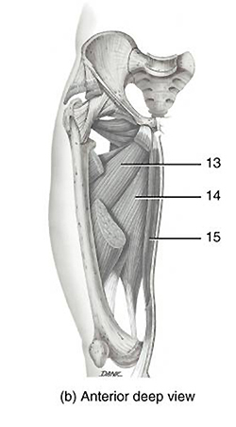

Slide 23
allen2e_14_07ab_li
Notes:
allen2e_14_07ab_li.jpg

Slide 25
allen2e_14_08ab_li
Notes:
allen2e_14_08ab_li.jpg

Slide 26
allen2e_14_08ab_li
Notes:
allen2e_14_08ab_li.jpg

Slide 27
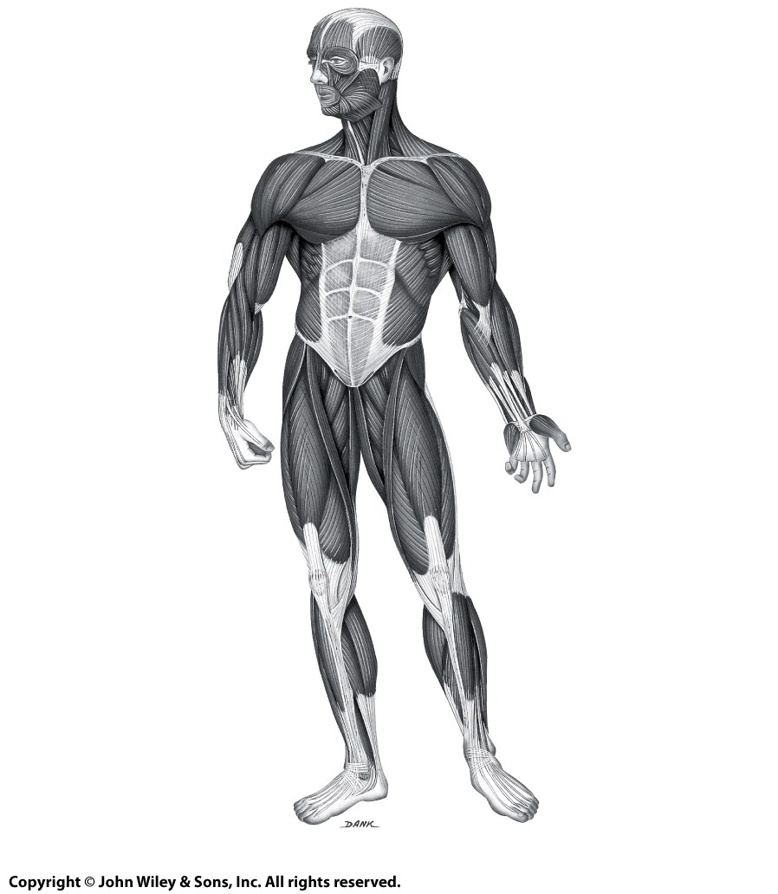
1
24
25
2
26
27
3
28
4
29
30
31
5
32
6
33
7
34
8
35
9
36
10
11
37
12
38
Extensor pollicis longus
39
13
Abductor
pollicis
longus
14
15
16
17
18
20
Patellar ligament
19
40
21
41
22
Tibia
23
(a) Anterior view
Calcaneal
(Achilles) tendon

Slide 28
1
24
25
2
26
27
3
28
4
29
30
31
5
32
6
33
7
34
8
35
9
36
10
11
37
12
38
Extensor pollicis longus
39
13
Abductor
pollicis
longus
14
15
16
17
18
20
Patellar ligament
19
40
21
41
22
Tibia
23
(a) Anterior view
Calcaneal
(Achilles) tendon

Slide 29
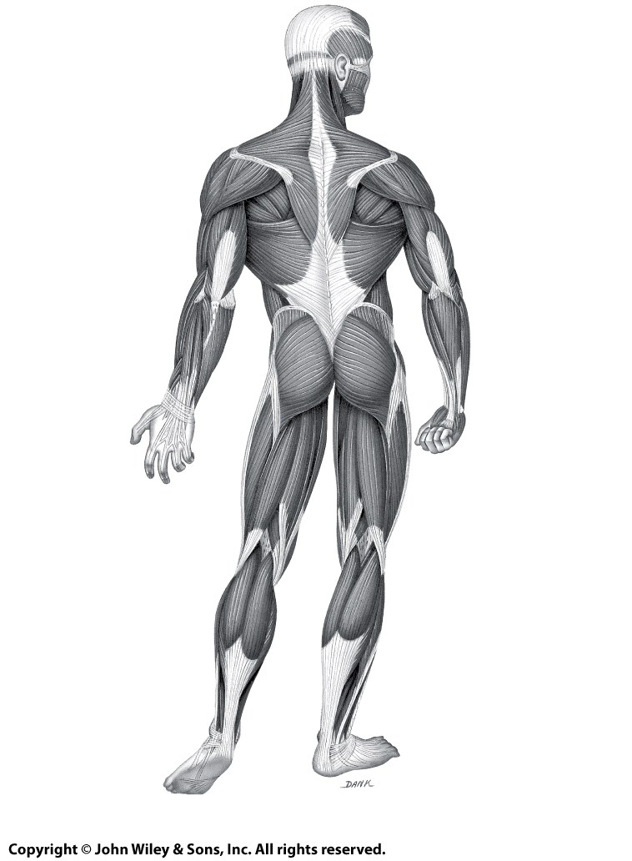
53
42
54
43
55
56
44
45
57
58
46
59
60
47
61
48
62
49
63
Abductor pollicis longus
64
65
Extensor pollicis brevis
66
67
68
69
50
72
70
71
51
73
74
Flexor hallucis longus
52
Extensor digitorum longus
(b) Posterior view

Slide 30
53
42
54
43
55
56
44
45
57
58
46
59
60
47
61
48
62
49
63
Abductor pollicis longus
64
65
Extensor pollicis brevis
66
67
68
69
50
72
70
71
51
73
74
Flexor hallucis longus
52
Extensor digitorum longus
(b) Posterior view

